Slide 1
A Warning.

Slide 2


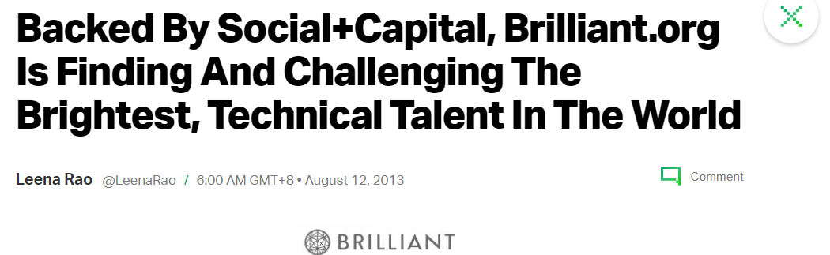
Introduction.
?

Slide 3

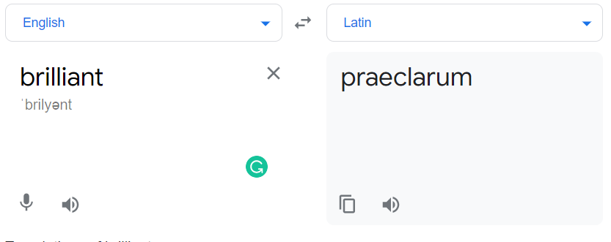

Slide 4
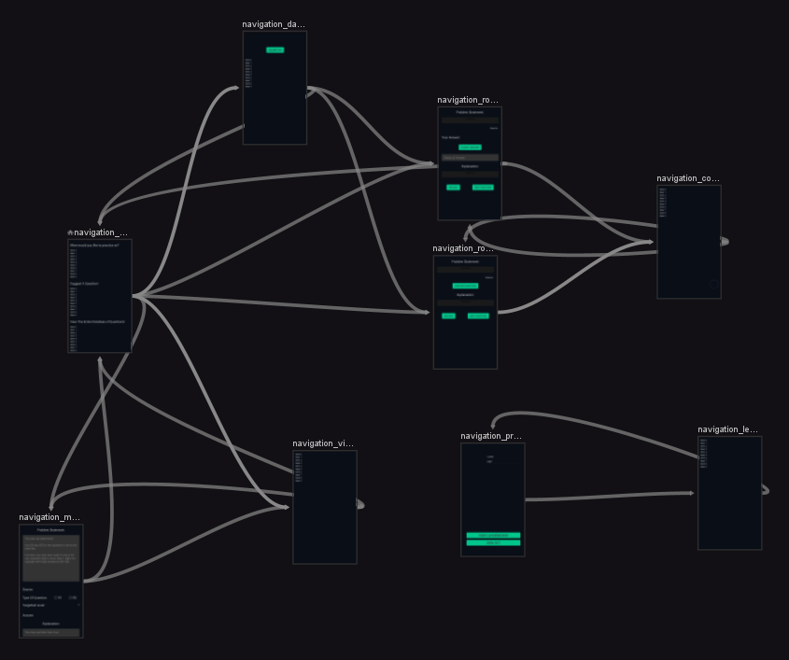
Motivation
Really had no clue what to do
Would be fun I guess (?)
It seems like a reasonable enough project size
Spoilers: It was, and that’s the problem

Slide 5
App Dev Process.

Slide 6
Planning. (+)?
paper.
Just paper.
Some help from aloy and prannaya and justin

Slide 7
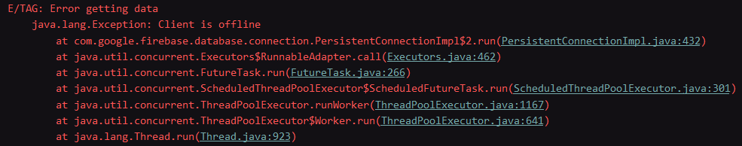
Depression Part 1: Firebase Sucks.
(Emulator still not restarted)

Slide 8

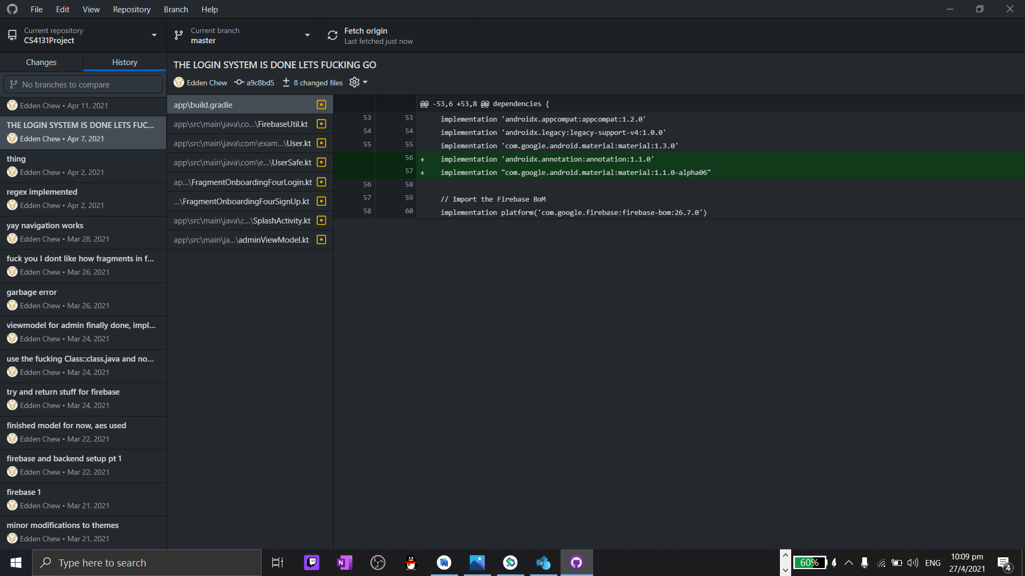
Depression Part 1: Firebase Sucks.
It worked ?

Slide 9

MO Training.

Slide 10
Live Demo!!
Main Functionalities

Slide 11

Comments.

Slide 12
Comments on the app.
Jude: UI is minimalistic, functional, and beautiful. The premise and concept of this app is good and fulfils a niche for MO students. The XP functionality seems a bit off as there is nothing else tied to the XP function. Otherwise, the functionality of this app is focused and and seems to fulfil the purpose of this app, other than a few minor details.

Slide 13
“nothing else tied to the XP function”
On EXP.

Slide 14

“In MO, it is not about you vs others. It is about you, against the questions.”
- Mr Teo, 2K {26-5}, probably at 7:26 AM

Slide 15
Live Demo!!
PART 2!!!

